Slide 1




Digital Devices & Computer Networks
Year 3 · How do computers think, talk and connect?

Slide 2








Buzzwords to master
Digital device
Input
Process
Output
Program
Network
Switch
Server
Wi-Fi
Access point
Cable
Internet
Can you explain every one by the end of today?
Notes:
Show at the start and again at the end. Pupils tick the buzzwords they can explain.

Slide 3

LESSON 1
Digital devices
How does a device take things in, think, and give things out?
Notes:
Lesson 1: Digital devices

Slide 4
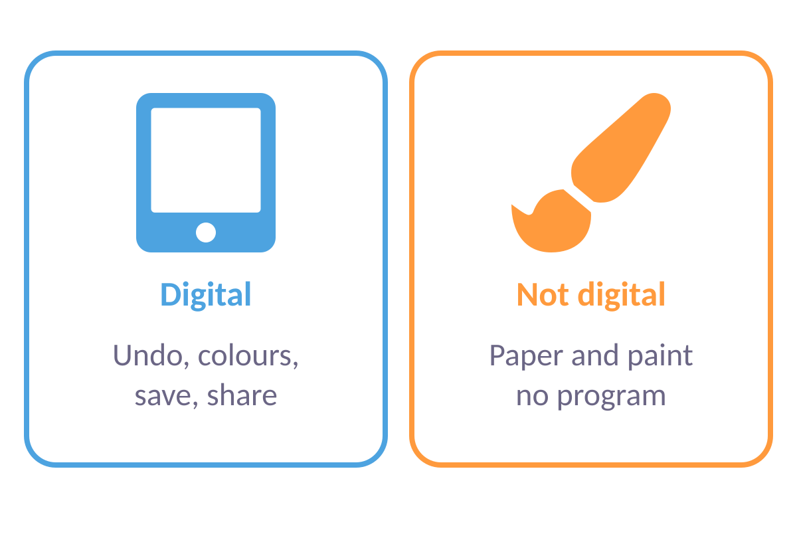
What makes a device “digital”?
DIGITAL DEVICE
A device with a brain that follows instructions
Program: instructions, like a recipe.
Digital: does MANY jobs, not just on/off.
Examples: tablet, laptop, phone.
Not digital: a torch. Just on or off!
Notes:
Pupils sort objects as digital or not. Misconception: electrical does not mean digital.

Slide 5
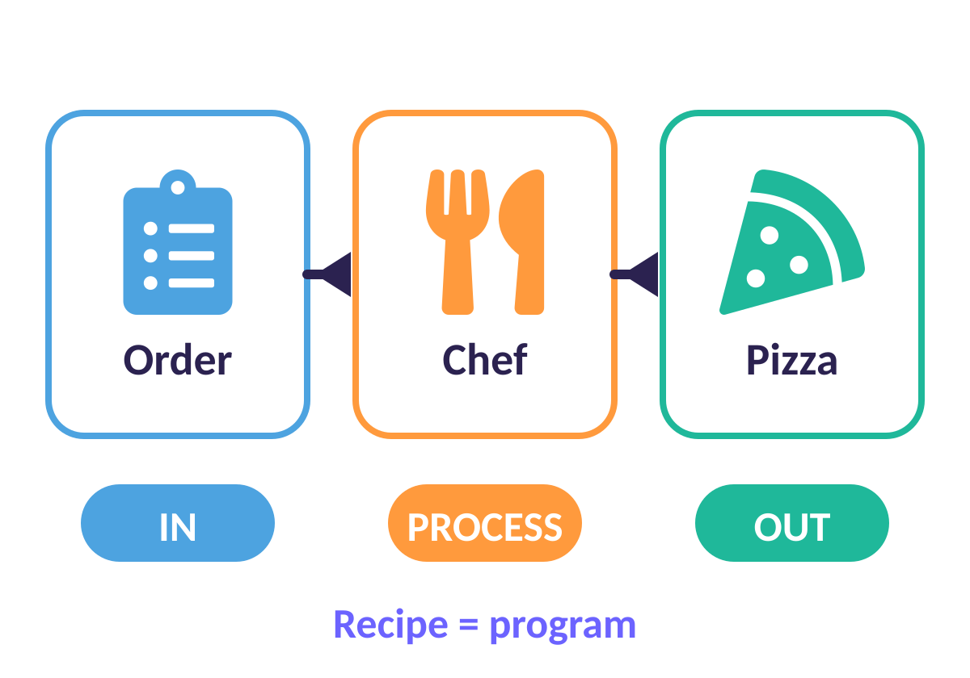
The kitchen secret: Input, Process, Output
IPO MACHINE
Every digital device works like a pizza kitchen
IN: the order arrives (input).
PROCESS: the chef follows the recipe (the program).
OUT: a pizza comes out (output).
Computer: press a key → program runs → letter on screen.
Notes:
Retell with a keyboard: key press (input), the program decides which letter (process), screen shows it (output).

Slide 6
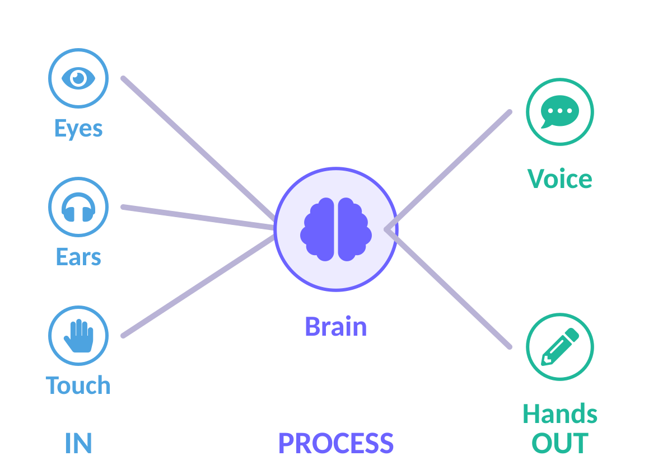
You are a digital device too!
IN → THINK → OUT
Your body does input, process and output all day
IN: eyes see, ears hear, hands feel.
THINK: your brain decides what to do.
OUT: your voice speaks, your hands write.
Computers: same idea, with parts instead of body parts!

Slide 7
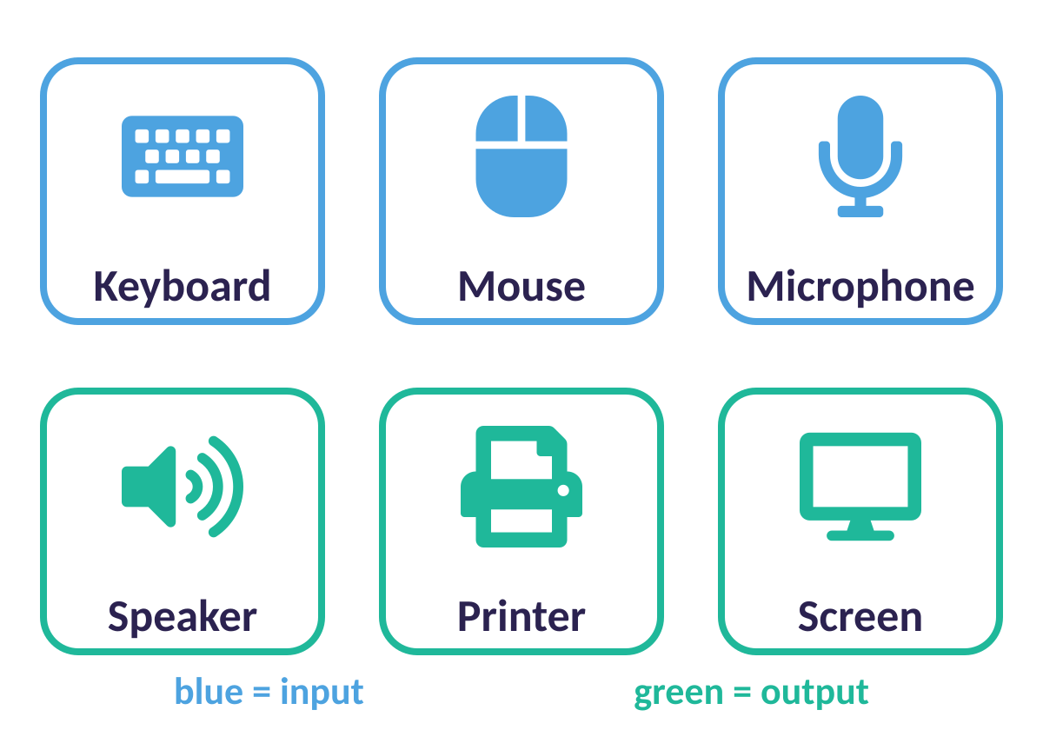
Input devices
INPUT = IN
The EARS, EYES and HANDS of a computer
Keyboard: types letters in.
Mouse and touchpad: point and click.
Microphone: hears your voice.
Camera and touchscreen: see and feel.
Notes:
Blue on the picture = input, green = output. Buzz mnemonic: Input = I put it IN.

Slide 8
Output devices
OUTPUT = OUT
The FACE, VOICE and HANDS of a computer
Screen: shows pictures and words.
Speakers: play sounds and music.
Printer: puts it on paper.
Lights: tell us the battery or power.
Notes:
Green on the picture = output. Mnemonic: Output = the computer puts it OUT.

Slide 9
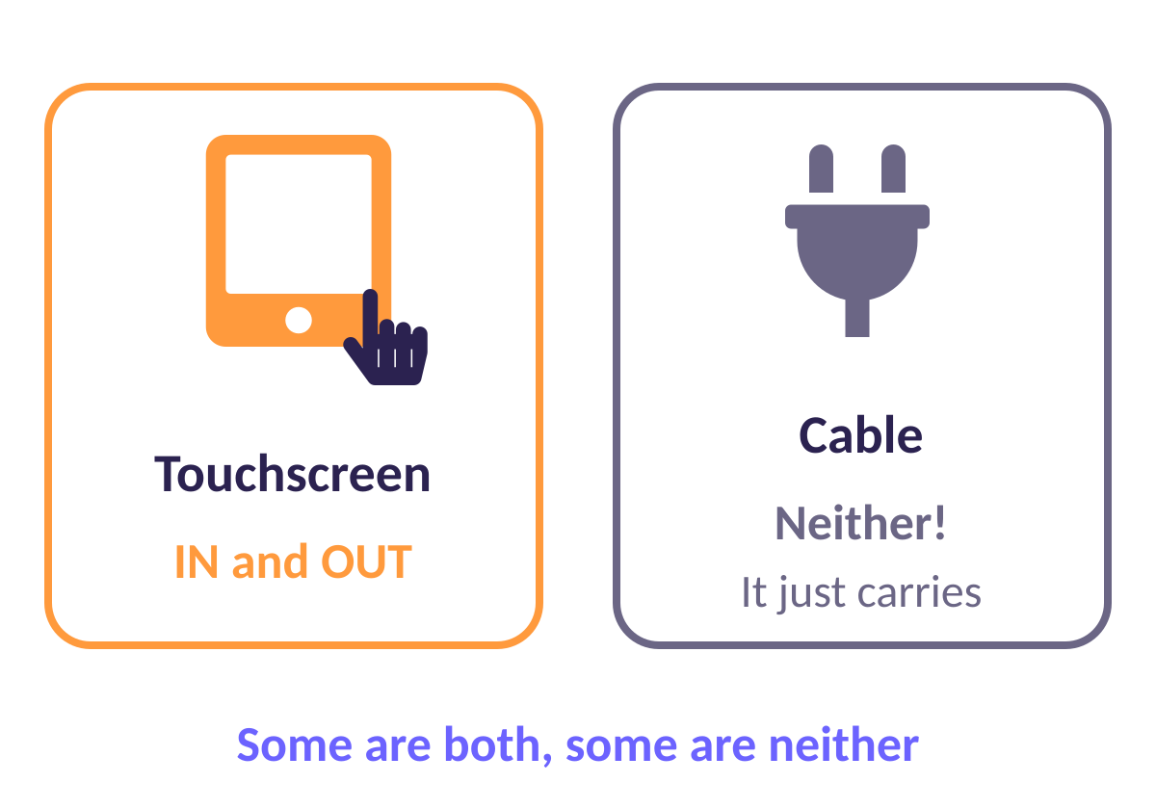
Both… and neither!
TRICKY ONES
Some parts do TWO jobs. Some do none!
Touchscreen: you touch it (IN) and it shows (OUT).
Cable: neither! It just carries information.
One-to-many: press play (IN) → picture AND sound (OUT).

Slide 10






Input, output, both or neither?
Keyboard
Speakers
Touchscreen
Microphone
Printer
Cable
Hold up: 1 finger = INPUT · 2 = OUTPUT · 3 = BOTH · 4 = NEITHER
Notes:
Hold up fingers, then reveal.

Slide 11





✔ Answers
Keyboard
Speakers
Touchscreen
INPUT
OUTPUT
BOTH
Microphone
Printer
Cable
INPUT
OUTPUT
NEITHER
Notes:
Hold up fingers, then reveal.

Slide 12
Quick quiz
Which is the OUTPUT in: press a key → letter appears on screen?
Pressing the key
A
The program working it out
B
The letter on the screen
C
Notes:
Pupils vote with fingers (1, 2, 3) or on mini whiteboards before the answer slide.

Slide 13
✔ The answer
Which is the OUTPUT in: press a key → letter appears on screen?
Pressing the key
A
The program working it out
B
The letter on the screen
C
Output = what comes OUT: the letter on screen.
Notes:
Pupils vote with fingers (1, 2, 3) or on mini whiteboards before the answer slide.

Slide 14
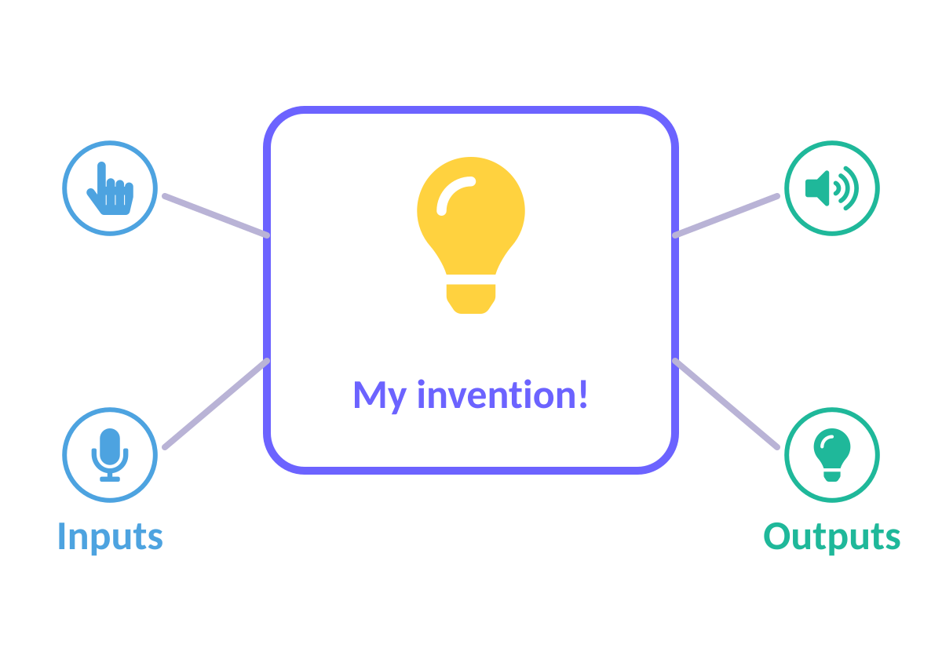
Activity: Invent a gadget!
ACTIVITY
Think of a gadget no one has made.
1
Draw it. Label ONE input and ONE output.
2
Write the process in a sentence.
3
Show a partner: can they spot IN, PROCESS, OUT?
4
Notes:
3 minutes. Share some inventions and praise correct vocabulary.

Slide 15
LESSON 2
Computer networks
How do computers talk to each other?
Notes:
Lesson 2: Computer networks

Slide 16
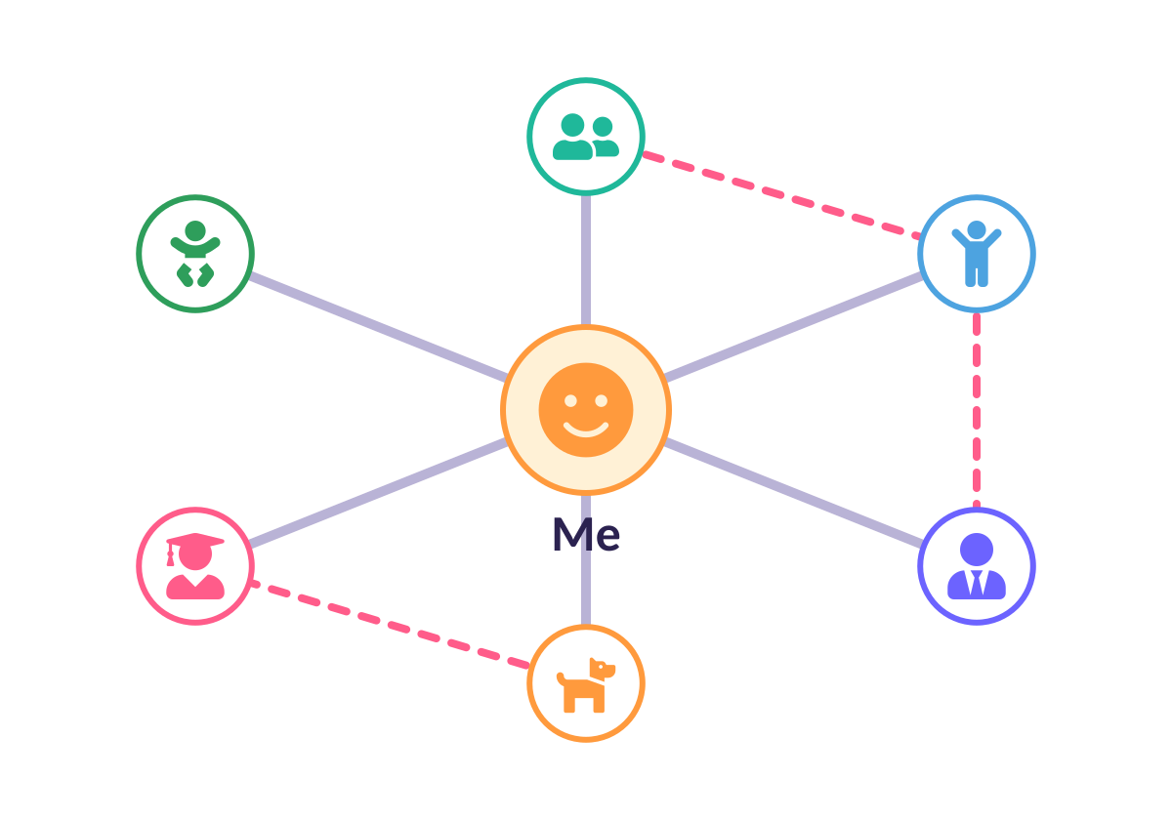
What is a network?
NETWORK
NET + WORK = linked things that help each other
Connection: a link between two things.
Your network: family and friends you can reach.
Computer network: computers linked to share files, printers and messages.
Notes:
Break the word: net (lines joining) + work (helping each other).

Slide 17
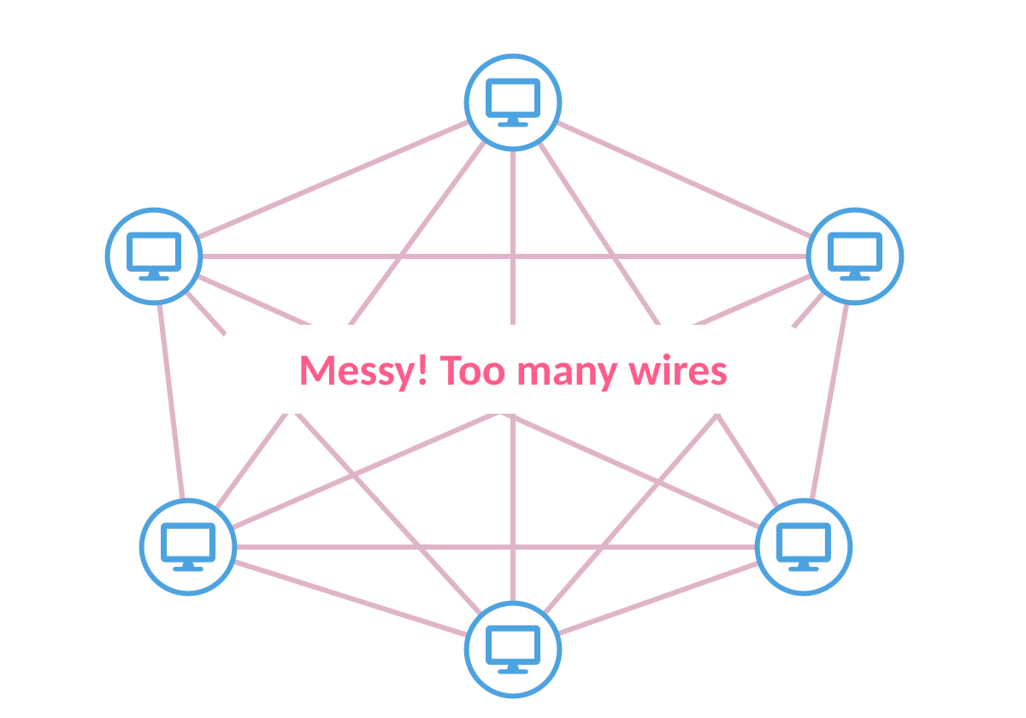
Why not join every computer to every other?
SPAGHETTI!
Too many wires, too slow, too messy
6 computers: 15 wires!
50 computers: 1,225 wires!
Solution: give everyone ONE wire to a smart helper.
Notes:
Quick maths for the curious: n×(n−1)/2 wires. 6 computers → 15; 50 computers → 1,225.

Slide 18
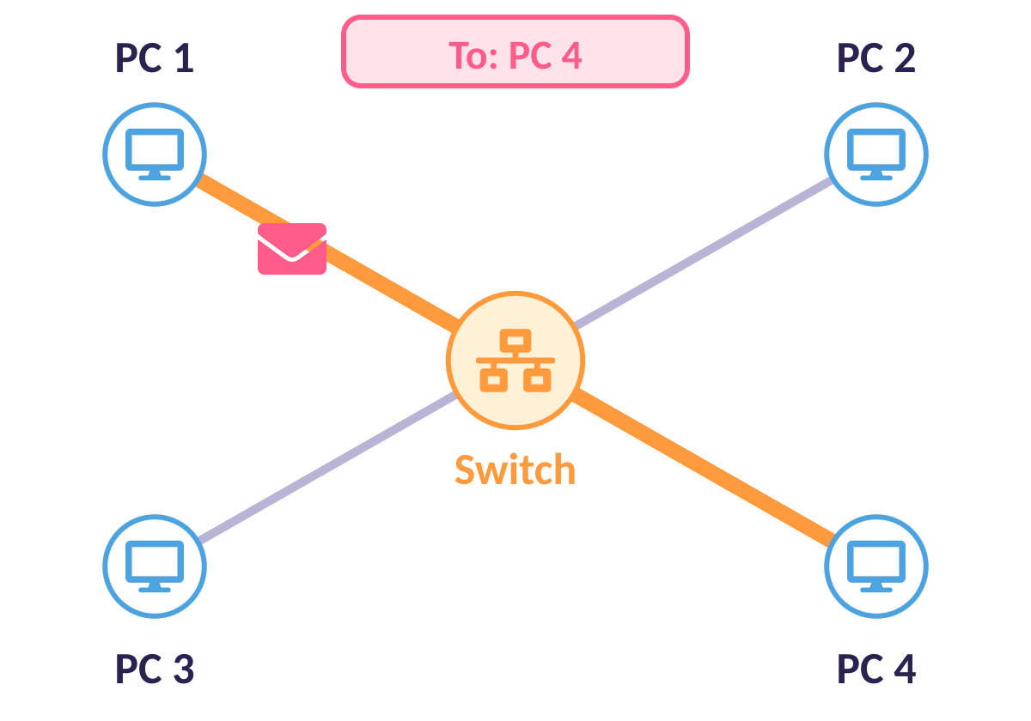
The switch
NETWORK SWITCH
The post office of the network
One wire: each computer plugs into the switch.
Reads the address: “To: PC 4” and nothing else.
Delivers: sends the message only to PC 4.
Fast and tidy: no digging through the post!

Slide 19
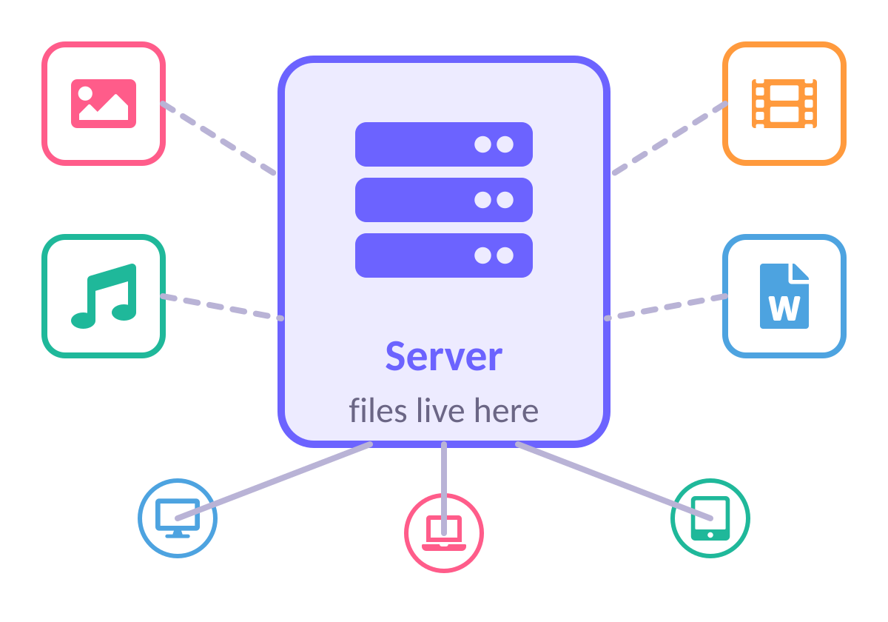
The server
SERVER
The school’s giant digital cupboard
Stores: everyone’s files in one safe place.
Shares: any computer on the network can open them.
Safe: backed up, so files are not lost.
Always on: even if YOUR computer is off!

Slide 20
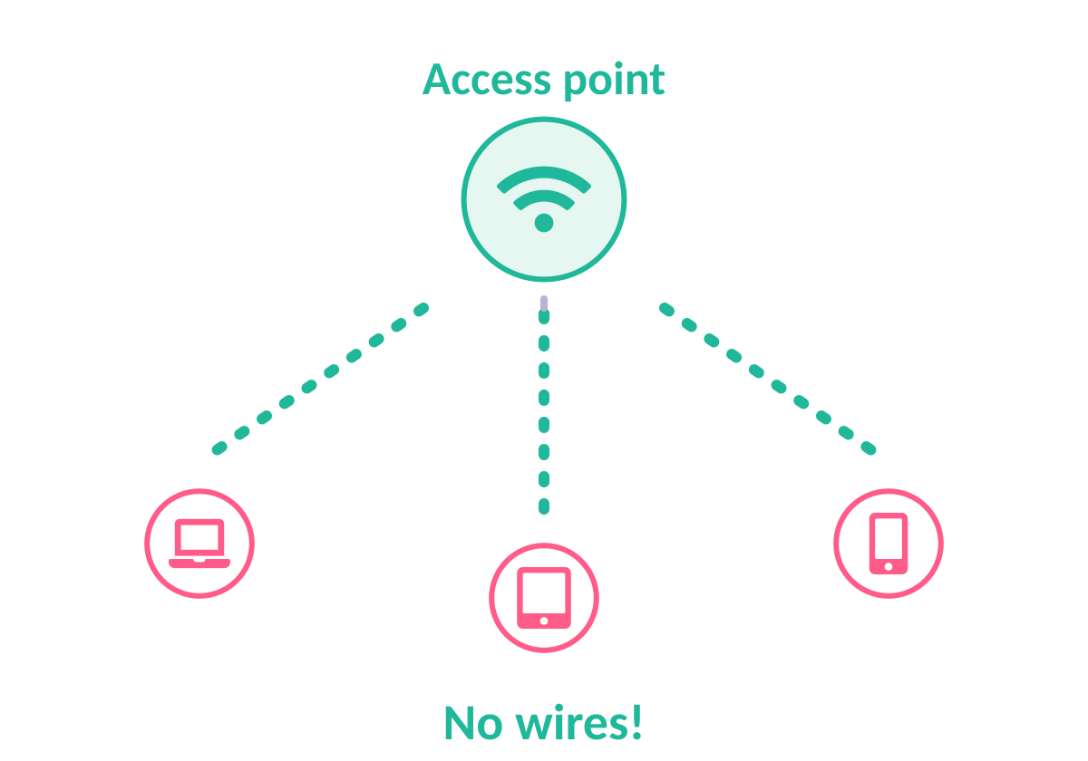
Wi-Fi and the access point
WI-FI
A cable you cannot see
Wireless access point: a box on the wall with a wire to the switch.
Sends signals: through the air to tablets and laptops.
Not the internet! Wi-Fi just connects you to the network.

Slide 21
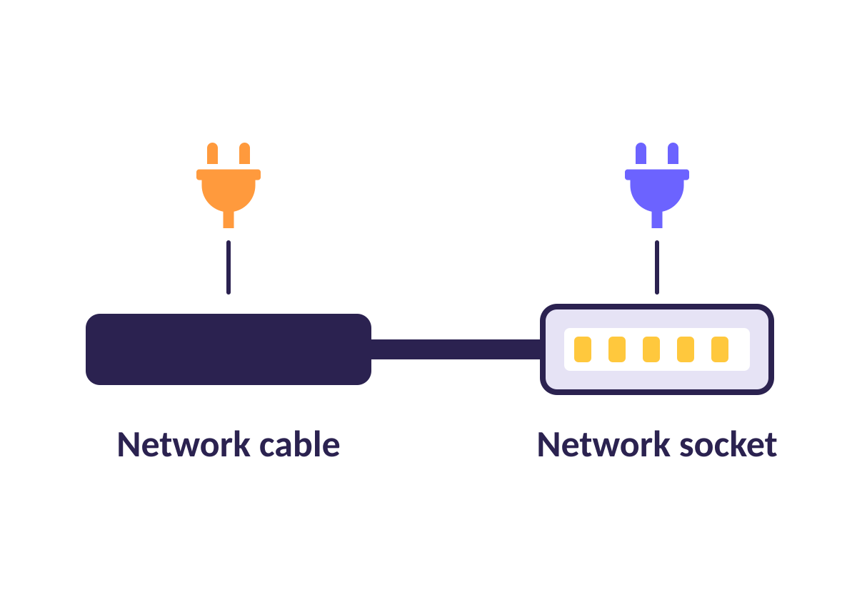
Cables and sockets
CABLE + SOCKET
The roads and doors of the network
Network cable: carries information like a road.
Network socket: the door in the wall where it plugs in.
Switch + server + access points: all joined by cables.
Notes:
Real name: Ethernet cable and Ethernet socket.

Slide 22
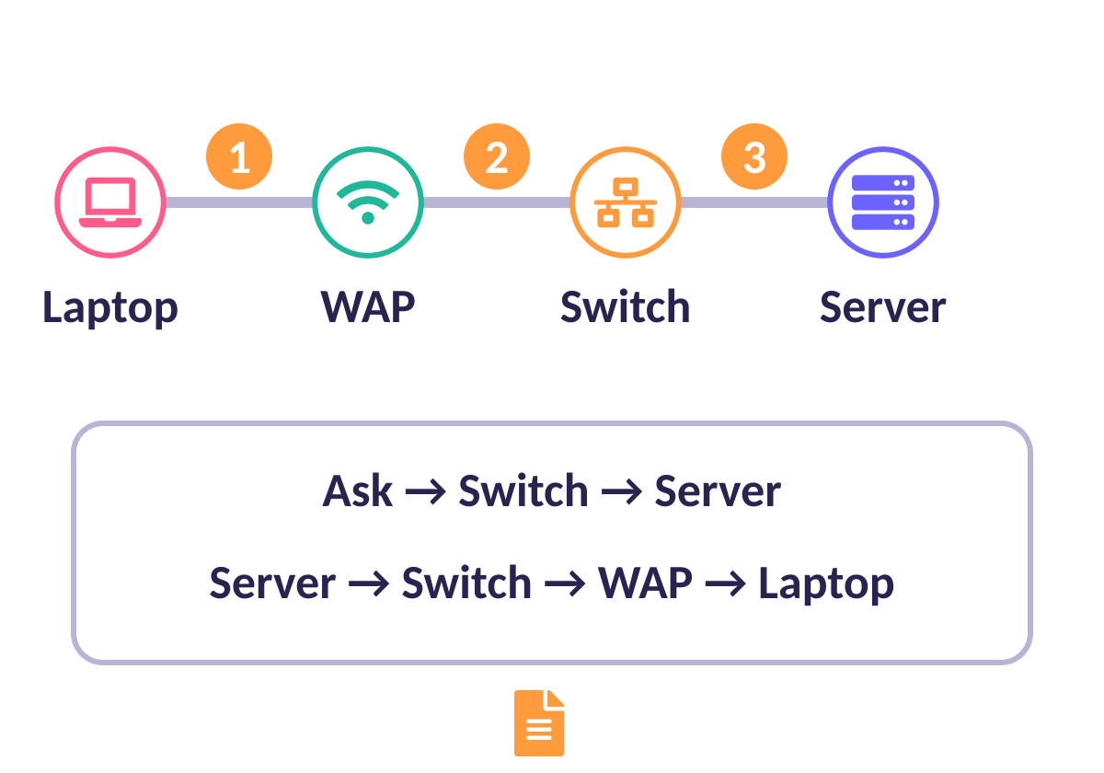
A file’s journey
STORY TIME
Mr Smith opens a maths worksheet on his laptop
1 Laptop asks the access point (Wi-Fi).
2 Access point passes it to the switch.
3 Switch finds the server.
4 The file travels back the same way.

Slide 23
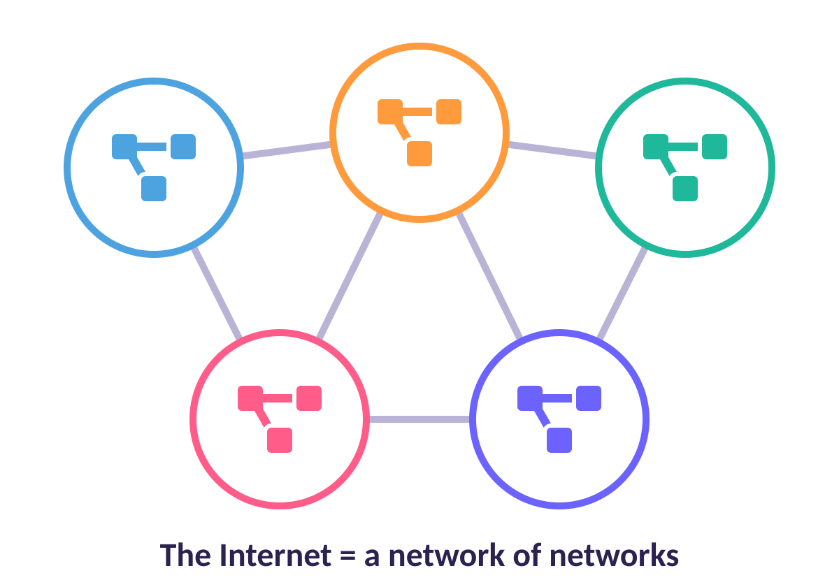
Networks join up!
INTERNET
A network of networks
Your school: one network.
Other places: their own networks.
Join them with routers: you get the INTERNET!
Coming next year: Year 4 explores it.

Slide 24
Quick quiz
What does a network switch do?
Stores all the files
A
Passes messages to the right computer
B
Makes the screen bigger
C
Notes:
Pupils vote with fingers (1, 2, 3) or on mini whiteboards before the answer slide.

Slide 25
✔ The answer
What does a network switch do?
Stores all the files
A
Passes messages to the right computer
B
Makes the screen bigger
C
It reads the address and delivers messages.
Notes:
Pupils vote with fingers (1, 2, 3) or on mini whiteboards before the answer slide.

Slide 26
Quick quiz
Where are the school’s files stored?
In the cable
A
On the server
B
In the switch
C
Notes:
Pupils vote with fingers (1, 2, 3) or on mini whiteboards before the answer slide.

Slide 27
✔ The answer
Where are the school’s files stored?
In the cable
A
On the server
B
In the switch
C
The server is the digital cupboard.
Notes:
Pupils vote with fingers (1, 2, 3) or on mini whiteboards before the answer slide.

Slide 28
Quick quiz
What lets tablets join the network with no wires?
A wireless access point
A
A paper clip
B
A printer
C
Notes:
Pupils vote with fingers (1, 2, 3) or on mini whiteboards before the answer slide.

Slide 29
✔ The answer
What lets tablets join the network with no wires?
A wireless access point
A
A paper clip
B
A printer
C
The access point sends and receives Wi-Fi.
Notes:
Pupils vote with fingers (1, 2, 3) or on mini whiteboards before the answer slide.

Slide 30



Think · Pair · Share
Explain to your partner using buzzwords: What is a network? What does a switch do?
Think
Pair
Share
Notes:
Listen for: connection, switch, server, access point, cable.

Slide 31




Brilliant work!
You are now experts. Keep asking questions!

